Slide 1
HEXPLODE
A Game of Unfriendly Explosions
PLAY GAME
GAME RULES

Slide 2
RULES
OBJECTIVE
The objective of the game is to eliminate the other player’s pieces from the board
HOW TO PLAY
During your turn you are allowed to add +1 charge to a single hexagon that is either neutral or of your color.
The number of circles on the hexagon represent how many clicks it takes for that piece to explode.
TIPS
Always grab a corner piece as your first move to gain a foothold for your defenses
Try chaining reactions to attack a player’s defenses
RETURN TO MENU

Slide 3
6
3
10
1
7
13
0
4
11
15
2
8
14
5
12
9
RETURN TO MENU

Slide 4
HEXPLODE
A Game of Unfriendly Explosions
PLAY GAME
GAME RULES

Slide 5
RULES
OBJECTIVE
The objective of the game is to eliminate the other player’s pieces from the board
HOW TO PLAY
During your turn you are allowed to add +1 charge to a single hexagon that is either neutral or of your color.
The number of circles on the hexagon represent how many clicks it takes for that piece to explode.
TIPS
Always grab a corner piece as your first move to gain a foothold for your defenses
Try chaining reactions to attack a player’s defenses
RETURN TO MENU

Slide 6
6
3
10
1
7
13
0
4
11
15
2
8
14
5
12
9
RETURN TO MENU

Slide 7
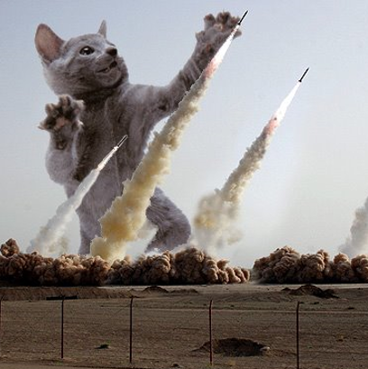
HEXPLODE
A Game of Unfriendly Explosions
PLAY GAME
GAME RULES

Slide 8
RULES
OBJECTIVE
The objective of the game is to eliminate the other player’s pieces from the board
HOW TO PLAY
During your turn you are allowed to add +1 charge to a single hexagon that is either neutral or of your color.
The number of circles on the hexagon represent how many clicks it takes for that piece to explode.
TIPS
Always grab a corner piece as your first move to gain a foothold for your defenses
Try chaining reactions to attack a player’s defenses
RETURN TO MENU

Slide 9
PLAYER 1
6
3
10
1
7
13
4
11
15
2
8
14
5
12
9
RETURN TO MENU

Slide 10
PLAYER 2
6
3
10
1
7
13
0
4
11
15
2
8
14
5
12
9

Slide 11
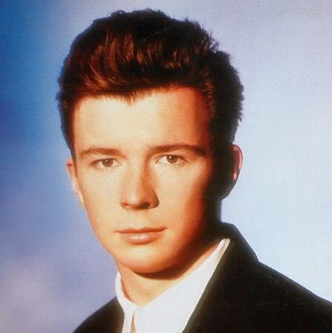
Player 1 WINS!
RETURN TO MENU
RETURN TO MENU

Slide 12
Player 2 WINS!
RETURN TO MENU
RETURN TO MENU

Slide 13
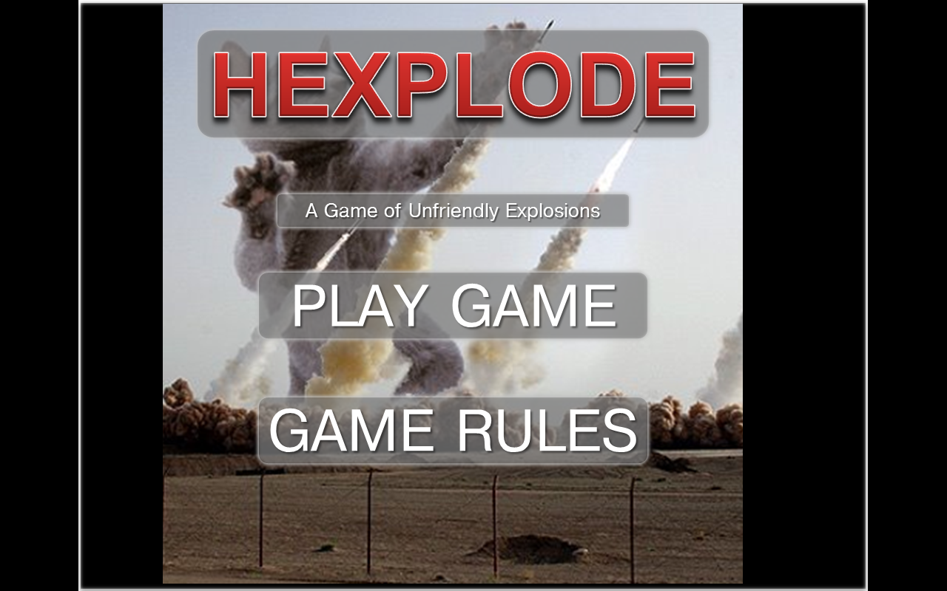
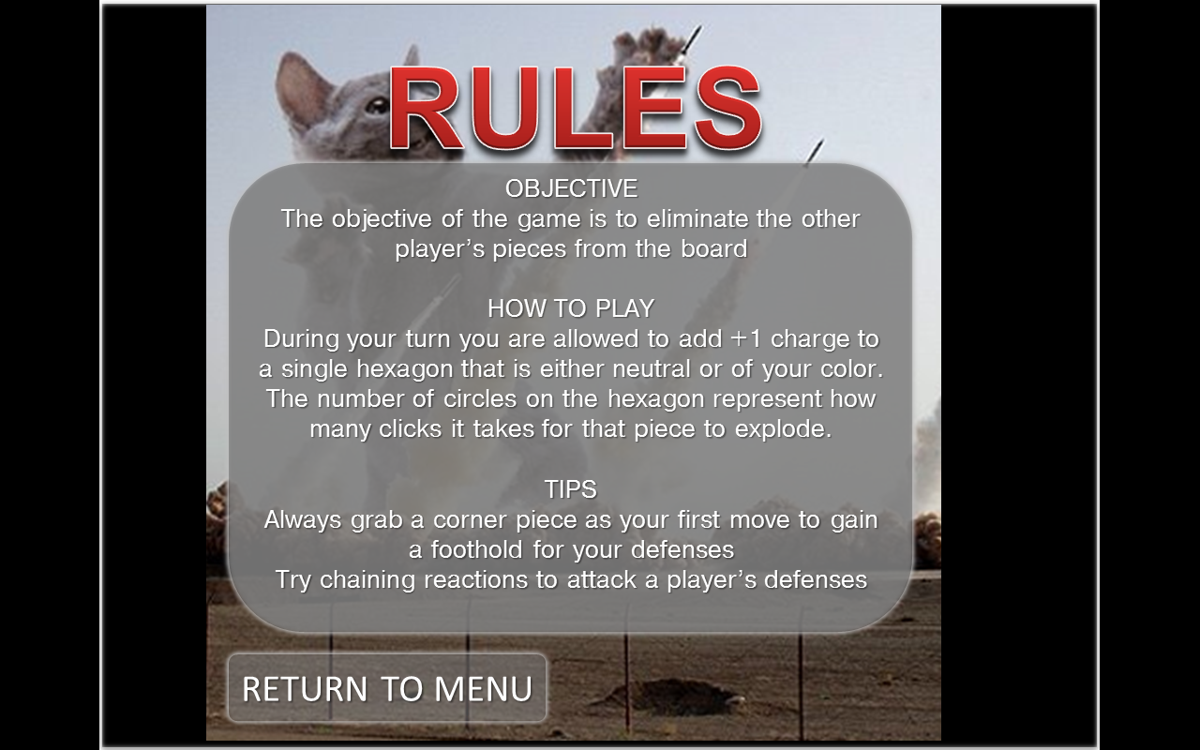
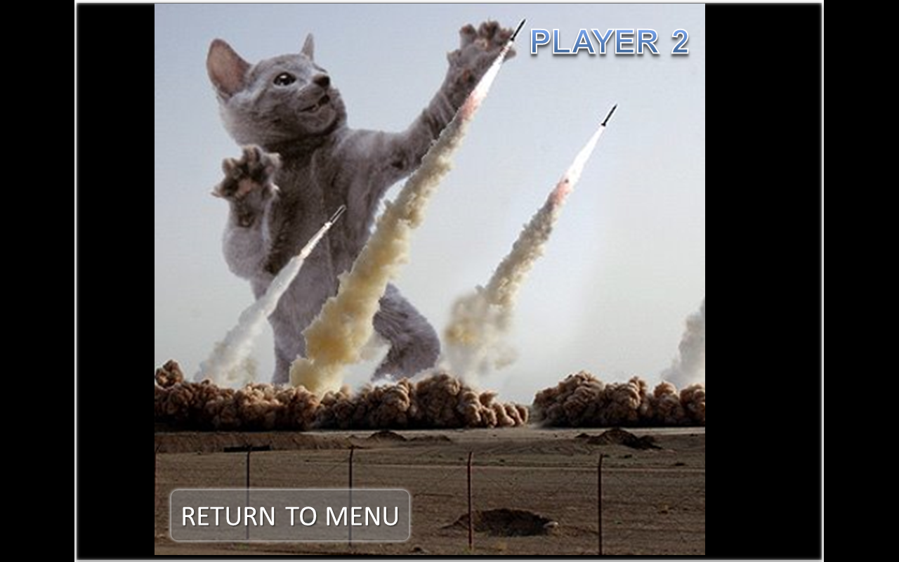
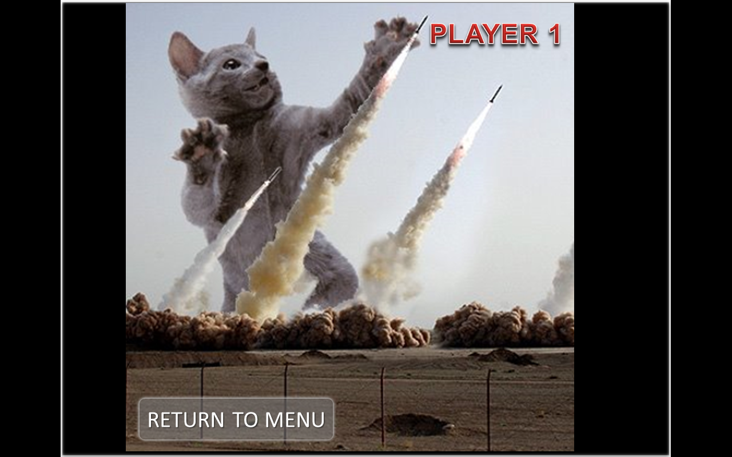

Slide 14
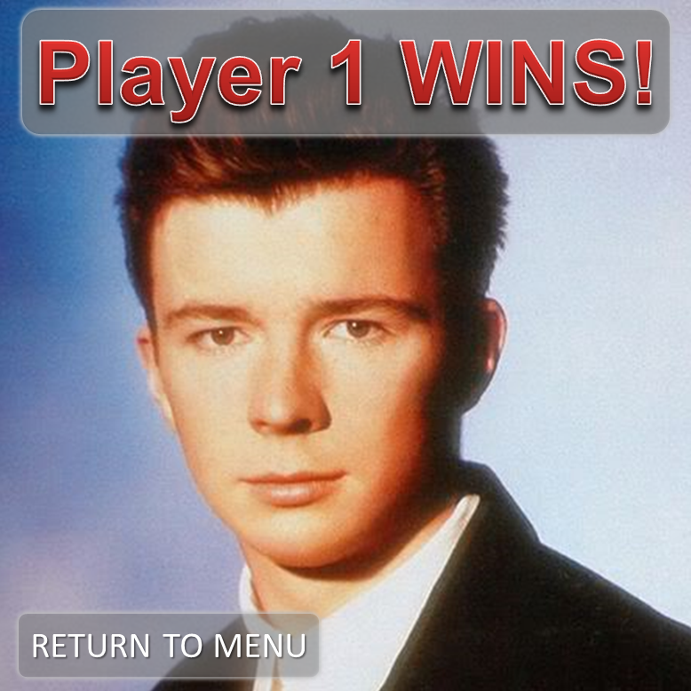
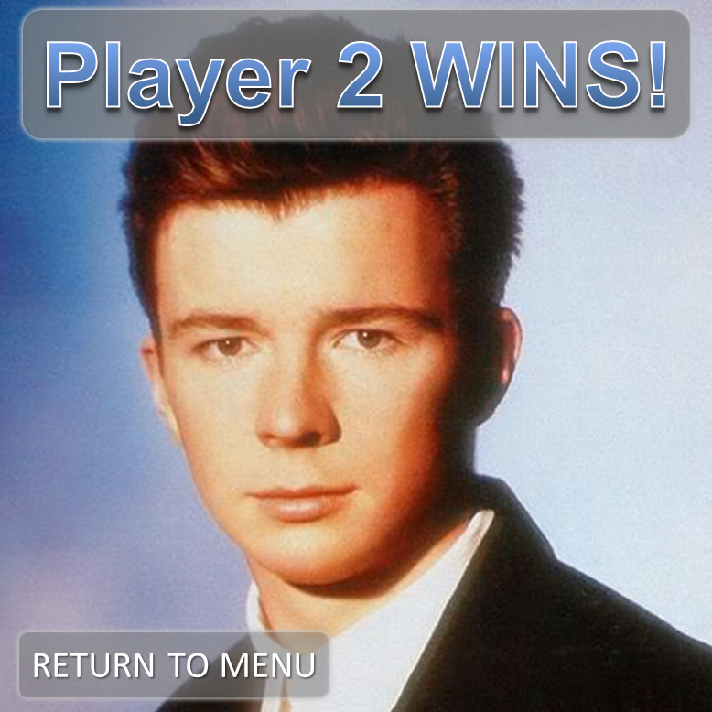
Notes:
107601052

Slide 15


Slide 16
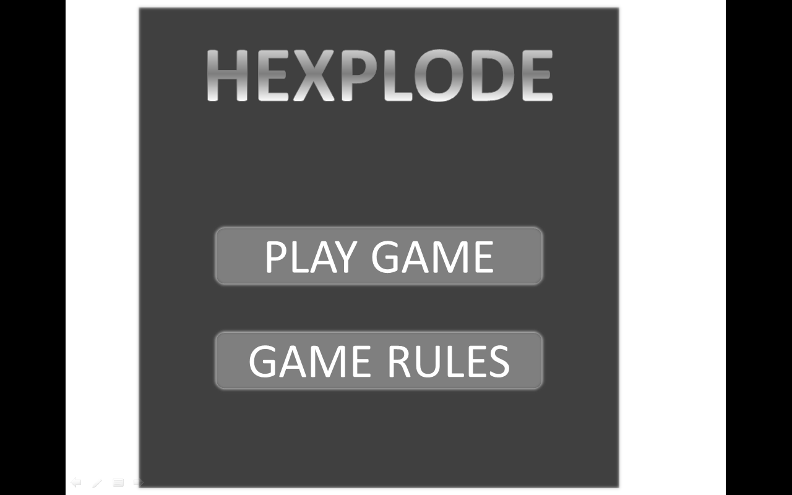
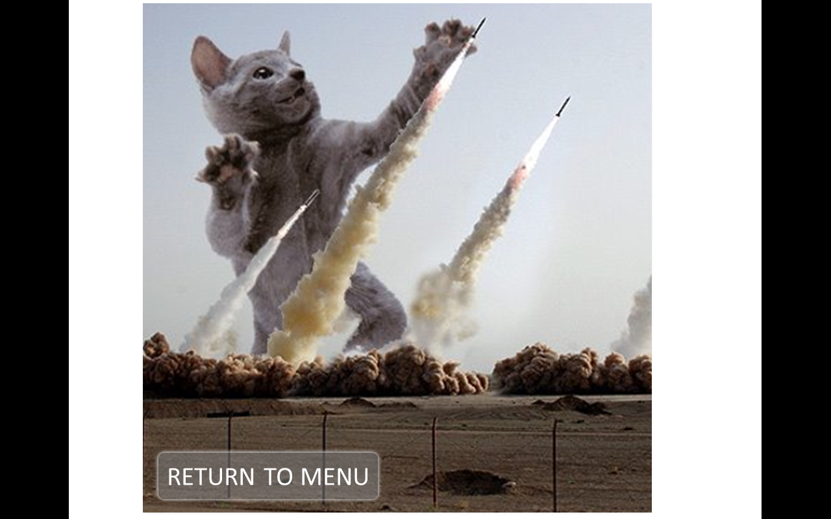
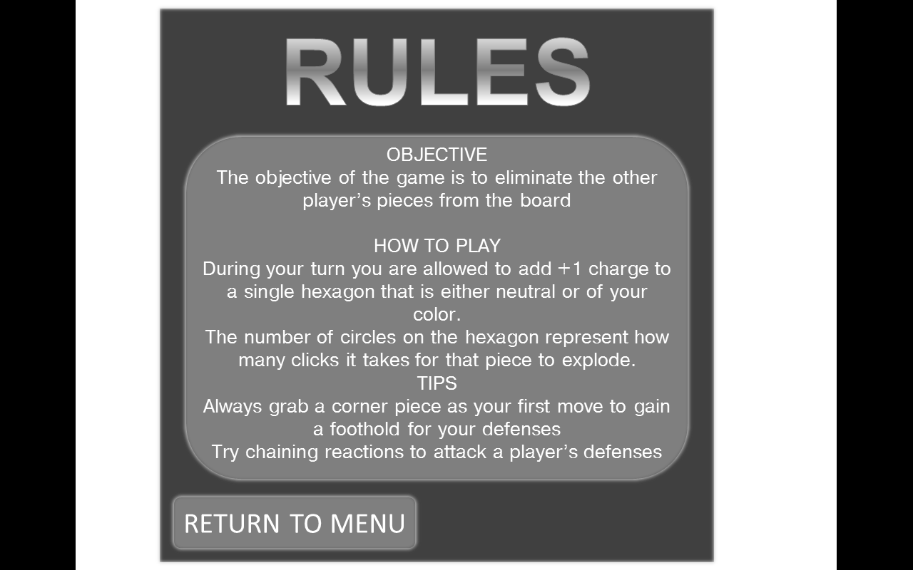
Notes:
4” by 5.33”

Slide 17
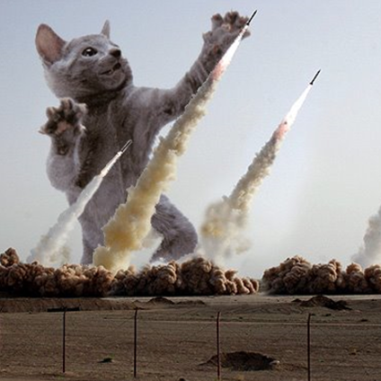
6
3
10
1
7
13
0
4
11
15
2
8
14
5
12
9

Slide 18
Title Music:
Ours Samplus
Spell on You
8Bit:
Tetris
Hooked on a feeling
Rick roll
Any way you want it
Radioactive (intro)
GRiZ:
DTW to DIA
Blastaa
Simple

